Slide 1
Co-Extracting Opinion Targets and Opinion Words from Online Reviews Based on the Word Alignment Model

Slide 2
Abstract
Mining opinion targets and opinion words from online reviews are important tasks for fine-grained opinion mining, the key component of which involves detecting opinion relations among words.
To this end, this paper proposes a novel approachbased on the partially-supervised alignment model, which regards identifying opinion relations as an alignment process. Then, a graph-based co-ranking algorithm is exploited to estimate the confidence of each candidate. Finally, candidates with higher confidence are extracted as opinion targets or opinion words.

Slide 3
EXISTING SYSTEM
The intuition represented by this strategy was that in sentences, opinion words usually co-occur with opinion targets, and there are strong modification relations and associations among them (which in this paper are called opinion relations or opinion associations).
Therefore, many methods jointly extracted opinion targets and opinion words in a bootstrapping manner . For example, “colorful” and “big” are usually used to modify “screen” in the cell-phone domain, and there are remarkable opinion relations among them.

Slide 4
Disadvantage
Detect the opinion relations among words is a considerable challenge in this task.
Bootstrapping framework, which has the problem of error propagation.
An iteration, they would not be filtered out in subsequent iterations

Slide 5
PROPOSED SYSTEM
we propose a method based on a monolingual word alignment model (WAM). An opinion target can find its corresponding modifier through word alignment.“colorful” and “big” are aligned with the target word “screen”.
Compared to previous nearest-neighbor rules, the WAM does not constrain identifying modified relations to a limited window; therefore, it can capture more complex relations, such as long-span modified relations.

Slide 6
ADVANTAGES
1. Candidates with higher confidence than a threshold are extracted.
2. Opinion targets were extracted in a standard random walk framework.
3. Frequency statistics and phrase detection, to detect the proper opinion targets/words.

Slide 7
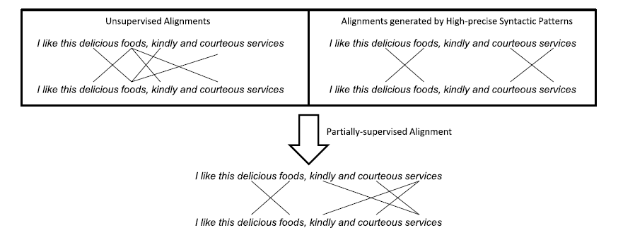
ARCHITECTURE

Slide 8
Software Requirements Specification
Software Requirements:
Operating System : Windows 7/Windows 8
IDE : Net Beans 8.0/7.3/6.8
Software setup : Jdk8/JDK 7/JDK 6
Technology : Java Standard Edition
Note : As per Operating system setting need to Install JDK (32bit/64 bit)

Slide 9
Hardware Requirements:
Processor : Any Processor above 500 MHz
RAM : 2 GB
Hard Disk : 10 GB
Compact Disk : 650 Mb
Input device : Standard Keyboard and Mouse

Slide 10
MODULES DESCRIPTION
Partially supervised alignment model
partially-supervised word alignment model (PSWAM). At first, we apply PSWAM in a monolingual scenario to mine opinion relations in sentences and estimate the associations between words.
Then, a graph-based algorithm is exploited to estimate the confidence of each candidate, and the candidates with higher confidence will be extracted as the opinion targets. Compared with existing syntax-based methods,

Slide 11
POS Tagging & Hill climbing
The standard word alignment model is usually trained in a completely unsupervised manner, which may not obtain precise alignment results.
Thus, to improve alignment performance, we perform a partial supervision on the statistic model and employ a partially- supervised alignment model to incorporate partial alignment links into the alignment process.

Slide 12
Partially Supervised candidate Extraction & word alignment
These methods usually adopted coarser techniques, such as frequency statistics and phrase detection, to detect the proper opinion targets/words.
They put more emphasis on how to cluster these words into their corresponding topics (or) aspects. we obtain a set of word pairs, each of which is composed of a noun/noun phrase (opinion target candidate) and its corresponding modified word (opinion word candidate).

Slide 13
Calculate candidate confidence :
we propose a graph-based co-ranking algorithm to estimate the confidence of each candidate. calculate the prior knowledge of candidates for indicating some noises and incorporating them into our ranking algorithm to make collaborated operations on candidate confidence estimations.
Finally, candidates with higher confidence than a threshold are extracted. Compared to the previous methods based on the bootstrapping strategy, opinion targets/words are no longer extracted step by step. Instead, the confidence of each candidate is estimated in a global process with graph co-ranking. Intuitively, the error propagation is effectively alleviated.

Slide 14
CONCLUSIONS AND FUTURE WORK
This paper proposes a novel method for co-extracting opinion targets and opinion words by using a word alignment model. Our main contribution is focused on detecting opinion relations between opinion targets and opinion words.
Compared to previous methods based on nearest neighbor rules and syntactic patterns, in using a word alignment model, our method captures opinion relations more precisely and therefore is more effective for opinion target and opinion word extraction

Slide 15
REFERENCES
[1] M. Hu and B. Liu, “Mining and summarizing customer reviews,” in Proc. 10th ACM SIGKDD Int. Conf. Knowl. Discovery Data Mining, Seattle, WA, USA, 2004, pp. 168– 177.
[2] F. Li, S. J. Pan, O. Jin, Q. Yang, and X. Zhu, “Cross-domain coextraction of sentiment and topic lexicons,” in Proc. 50th Annu. Meeting Assoc. Comput. Linguistics, Jeju, Korea, 2012, pp. 410–419.
[3] L. Zhang, B. Liu, S. H. Lim, and E. O’Brien-Strain, “Extracting and ranking product features in opinion documents,” in Proc. 23th Int. Conf. Comput. Linguistics, Beijing, China, 2010, pp. 1462–1470.

Slide 16
ANY QUERIES

Slide 17
THANK U

